Slide 1
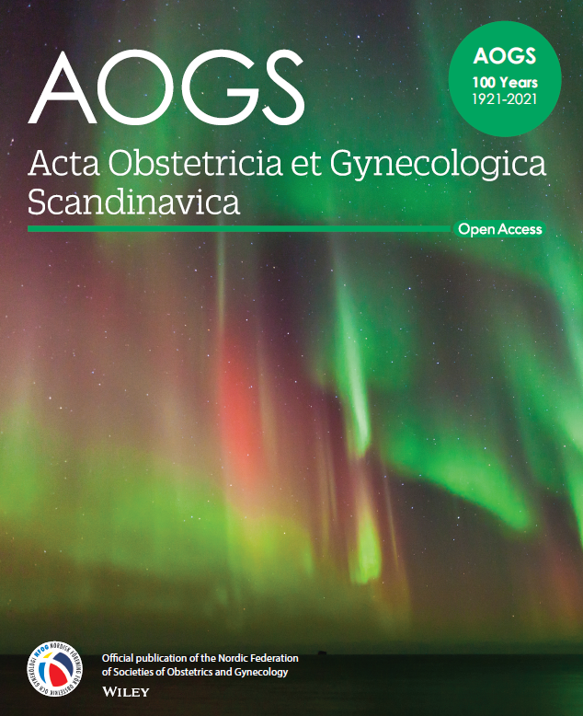

Developments in AOGS

Slide 2
Why AOGS went Open Access
Ganesh Acharya, Editor-in-Chief of Acta Obstetricia et Gynecologica Scandinavica, comments:
OA is the future, it increases visibility, reaches wider readership quickly and improves scientific impact of published articles.
AOGS Editorial Board and NFOG Board unanimously supported transition to Gold OA.
Gold OA is compliant with the Open Science strategy and Plan S of European Union and Nordic countries as well as the Research Councils and other funding organizations internationally.
More than half (56%) of our accepted articles in 2019 were submissions from countries and institutions with transitional OA publishing deals/agreements with our publisher, Wiley.

Slide 3
Wiley’s Transformational Agreements
Type of Transformational Agreement
Although each agreement is unique, they share many common elements, and combine read access with Open Access publishing
Read-and-Publish is an agreement in which a publisher receives payment for reading and payment for publishing, combined in a single contract. Over the term of the agreement, the payment for publishing increases, while the payment for reading decreases. An example of this is Wiley’s agreement with JISC (UK)
Publish-and-Read is an agreement in which the publisher receives payment only for publishing, and reading is included for no additional cost. An example of this is Wiley’s agreement with Projekt DEAL (Germany)
How prevalent are they?
According to the ESAC Registry there are currently over 480 agreements, covering over 225,000 articles.
Wiley has more than 40, accounting for around 30% of the articles currently published under transformational agreements.

Slide 4

Wiley’s Transformational Agreements
NFOG: Support for Members
Wiley currently has 14 Transformational Agreements that cover publication in Gold OA journals. Click here to see if your APC could be covered.
NFOG members whose country does not have a Wiley Open Access Account agreement for APC payment can request 100% APC reimbursement from NFOG after acceptance. For further details, please contact susana.benedet@gu.se
Gold OA Agreements:
Australia/CSIRO
Finland/FinELib
Germany/Projekt DEAL
Hungary/EISZ
Ireland/IReL
Italy/Bibliosan
Norway/Sikt/UNIT
Sweden/BIBSAM
UK/JISC
USA/Carnegie Mellon University
USA/CDL
USA/Iowa State University
USA/US Department of Energy
USA/VIVA
Waivers
For authors publishing in Wiley's fully Gold open access journals, Wiley offers waivers and discounts to corresponding authors based in low- and lower middle-income countries.

Slide 5
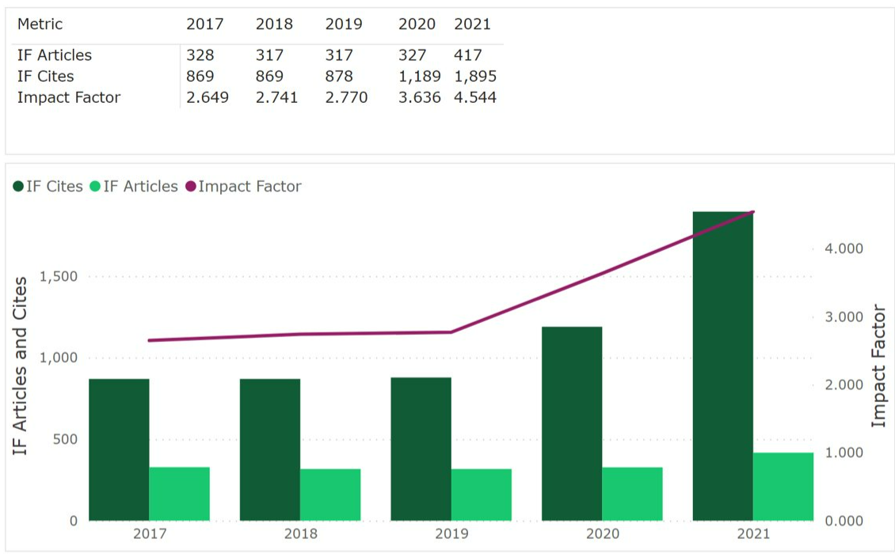

2021 Impact Factor
This graph shows the data behind the Impact Factor calculation for Acta Obstetricia et Gynecologica Scandinavica,
and how they have driven the trend in Impact Factor scores over time.

Slide 6
Publication Turnaround Times
Speed of review process
Country/region of submission
Includes all articles, including those that were rejected without peer review
Median number of days (min-max) | 2017 | 2018 | 2019 | 2020 | 2021
Submission to first decision | 7 (1-121) | 5 (1-135) | 5 (1-137) | 2 (1-142) | 2 (1-176)
Submission to final decision | 7 (1-470) | 5 (1-394) | 5 (1-425) | 2 (1-456) | 3 (1-306)
Submission to acceptance | 112 (1-470) | 96 (1-394) | 97 (1-425) | 108 (1-456) | 102 (1-306)
Excluding articles that were rejected without peer review
Median number of days (min-max) | 2017 | 2018 | 2019 | 2020 | 2021
Submission to first decision | 44 (4-121) | 41 (2-135) | 42 (3-137) | 37 (1-142) | 40 (1-176)
Submission to final decision | 60 (4-470) | 60 (2-394) | 61 (3-425) | 59 (1-456) | 63 (2-306)
Submission to acceptance | 117 (24-470) | 113 (10-394) | 122 (11-425) | 119 (7-456) | 111 (6-306)

